Slide 1
Completion Report: d. b. t. Star college scheme FILE NUMBER: BT/HRD/11/026/2020
Sri Tika Ram Kanya Mahavidyalaya, Aligarh
Student Strength approx. 3500 (2024-25)
www.trkpgcollege.com
trkmvpgcollege@gmail.com, drrekhaarya@gmail.com
Grant in Aid+ Self Finance (12B and 2f) Women’s College
Raja Mahendra Pratap Singh State University, Aligarh
(Previously associated with Dr. B.R.A. University, Agra)

Slide 2
Instruments: Botany
Proposed
Plant Growth Chamber -01
Trans Illuminator (2)
Gel Electrophoresis Units (6)
Micropipettes (10)
Centrifuge (2)
Bact. Shaker Incubater -01
Laminar Flow System -01
Water baths - 04-01
Auto clave-01
Deep fridge -20⁰C
Refrigerator - 01
Purchased
Plant Growth Chamber-1Unit
UV Transilluminator- 02
Gel Electrophoresis Unit -04
Micropipettes -06+0
Centrifuge – 2 unit
Bact. Shaker Incubator
LAF System -1 Unit
Water Bath – 04
Vertical Autoclave 1 unit
Deep Freezer -1 Unit
Refrigerator -1 Unit
Sanctioned Cost- 10,00000.00
Total Cost- 952635.50
Sanctioned -20 L – Expenditure- 19.29344 L Refund- 0.70656 L
(Bharat.kosh

Slide 3
Instruments: Zoology
Proposed
ELISA Unit -01*
PCR -01
Trans Illuminator -2
Gel Electrophoresis Units- 06
Micropipettes -10
Centrifuge -02
Bact. Shaker incubator
Laminar Flow System -01**
Water baths -04
B.O.D. Unit -01
Microtome
B.P. Instruments (10)
Purchased
Digital Microscope -01 unit*
PCR- 01unit
UV TransIlluminator-02 unit
Gel Electrophoresis Unit – 04
Micropipette- 04 unit
Centrifuge- 02 unit
Shaker Incubator-01 unit
BOD Incubator-01 unit
Waterbath-04 unit
Microtome-01 unit
Digital B.P- 06 unit
Analog B.P-10 unit
Sanctioned Cost- 10,00000.00
Total Cost- 976708.50
*Instrument not purchased due to over costing
** Instrument not purchased as department has 2 units already
*Instrument purchased after due permission process

Slide 4
Extension of Information-

Slide 5
Completion Report for d. b. t. Star college scheme
File Number: BT/HRD/11/026/2020
(SAN No.102/IFD/SAN/4036-4038 /2019-20 dated 29.02.20)
Principal: Prof. Sharmila Sharma
Co Ordinator: Prof Rekha Arya (HOD, Botany)
Duration: 29.02-2020 - 28.02 2023
Departments Involved: BOTANY AND ZOOLOGY
Total Amount Sanctioned – 44 L
Amount Released – 28 L
Expenditure- 24.70961L

Slide 6
DEPARTMENTS : BOTANY AND ZOOLOGY
Current Student Strength 2024-25 ODD SEM -181+159+ 143
BOTANY
ZOOLOGY
Permanent Faculty
Prof. Rekha Arya
Head of Department.
Dr. Beenu Tripathi, Asstt. Prof.
Self Finance Faculty
Dr. Mudassara Hasan
Ms. Purnima Varshney
Lab Staff- 02
02 labs
01 Instrument lab
01 Small Botanical Garden
Permanent Faculty
Dr Padma Saxena, Asstt. Prof.
Head of Department
Ms. Soni Singh.
Self Finance
Ms. Kamini
Lab Staff-02
02 labs
01 Instrument lab.

Slide 7
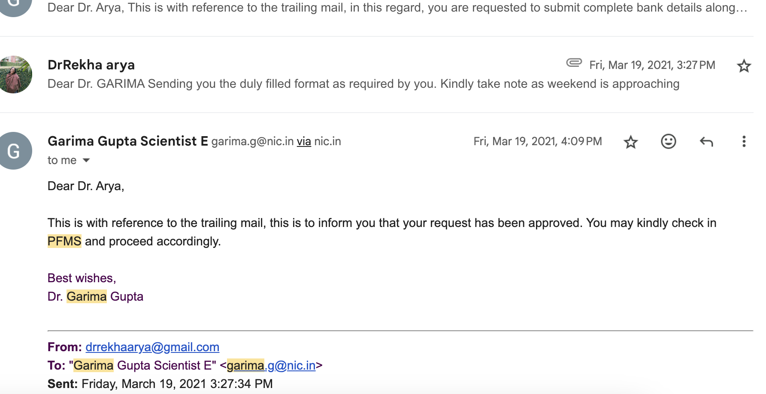
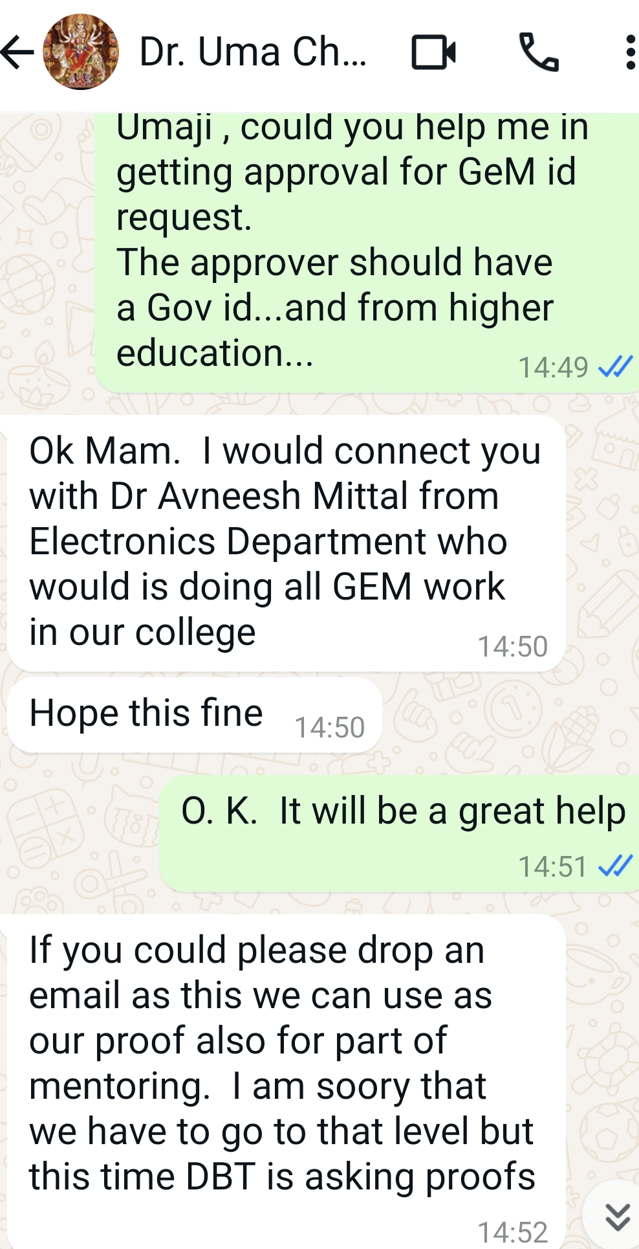
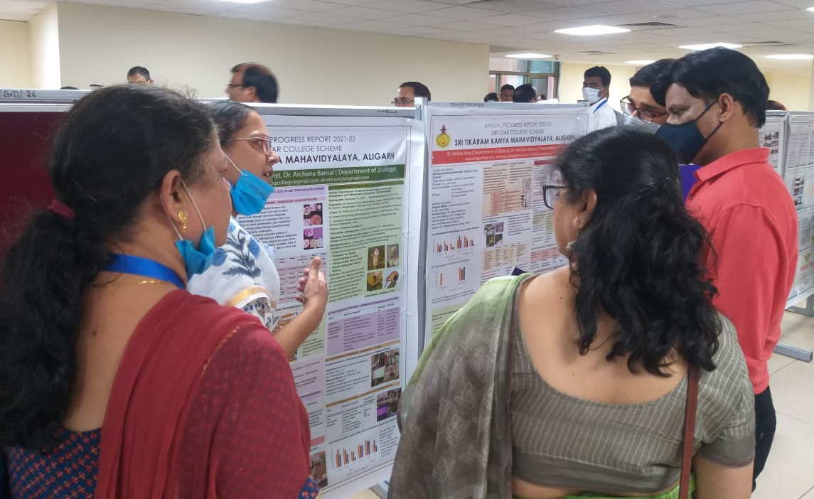
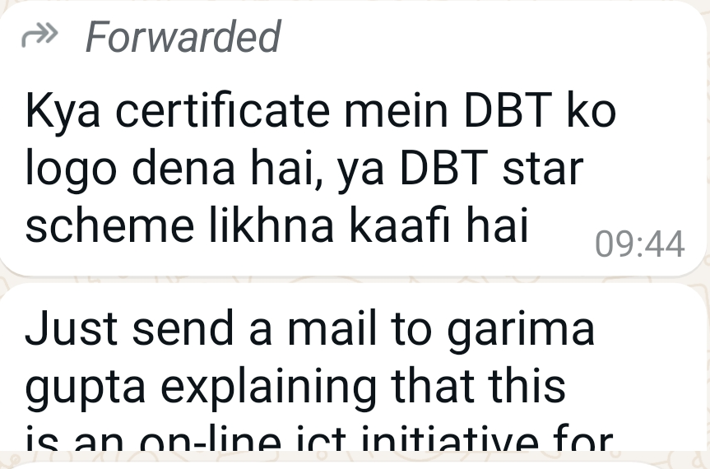
Mentorship Received
ADVISORY COMMITTEE
MEETING
Dr. Garima Gupta (Program Officer). Scientist E, Department OF biotechnology, Delhi
Prof. Seema Bhadauria. External Expert. Principal, Balwant Vidyapeeth Rural Institute, Agra
Prof. Uma Chaudhary (External Expert) Department of Biomedical Sciences, Bhaskaracharya College of Applied Sciences, Delhi.
Offline meetings:
None (due to pandemic)
Online communications:
regular emails, calls and chats
Coordinators Meet cum 13th Task meeting of Task force 4th-6th Aug 2022
presented posters (APR 2020-21 and 2021-22)

Slide 8
SOME EXCLUSIVE CONDITIONS DURING GRANT PERIOD
COVID 19- PANDEMIC AND
NEP 2020 IMPLEMENTATION IN COLLEGE FROM 2021-22

Slide 9
Goals Proposed/Goals Achieved
To enrich the infrastructure of both the departments
Skill development and training at the teacher/staff level
To organize skill development programs and enhance the exposure of students
 | Number | No of New Exercises done | No of participants
INSTRUMENTS Botany | 12 | 09 | Approx 500
INSTRUMENTS Zoology | 11 | 09 | Approx 500
WEBINARS | 05 | --- | 959
VIRTUAL Labs | 04 | --- | 785
ONLINE OUTREACH ACTIVITIES | 04 | --- | 1280
HANDS ON TRAINING | 04 | --- | 417
OFFLINE LECTURES | 04 | -- | 298

Slide 10
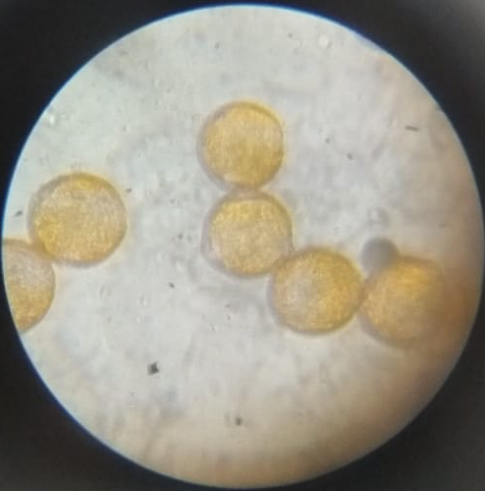
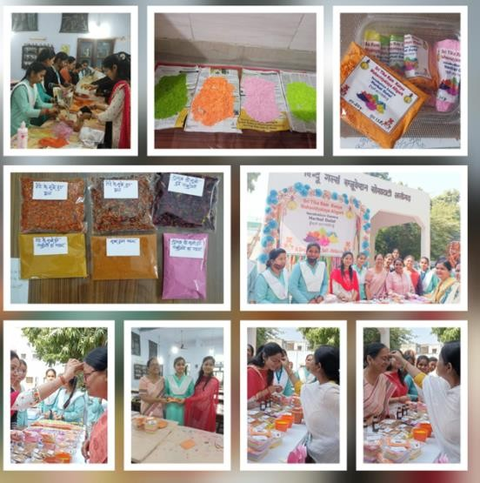
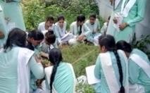
Qualitative Improvements: Minor projects Botany
Study on Structural Characteristics of Some Selected Pollen Grains
Innovation, Skill Development and Entrepreneurship: Herbal Preparations.Preparation of herbal colour and cosmetics.
Study on weed diversity in grassland community of college campus in different seasons. ( A paper has been published)
Preparatory Characteristics of some ayurvedic and unani medicines and oils.
Survey of airborne common mycoflora in different seasons in college campus.
Creating Awareness of phyto-diversity of college campus through social media
Notes:
If a few questions can be added to each subject it will be good. For example instead of saying study of plant disease symptoms, if we say like studying the plant disease affecting local crops and predicting a plan to get remedy of such disease.
I mean to say by strengthening on the importance of what is proposed to study. Like Study of pollen, how it could be useful.

Slide 11
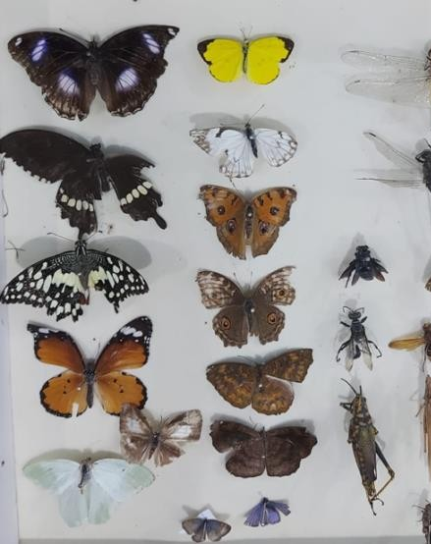
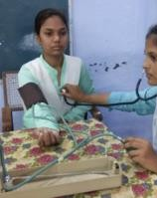
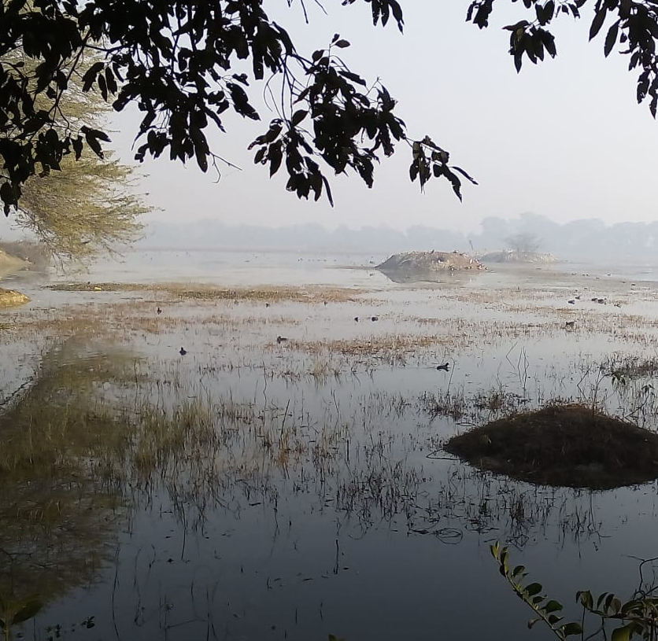
Qualitative Improvements: Minor projects Zoology
Field study collection and preservation of insects.
Physicochemical properties of different water samples
Survey on health status of young women and to corelate it with their socio- economic status based on parameters like B.P., Hemoglobin , BMI, and blood group of students

Slide 12
Virtual Labs: UG &PG Students Aligarh Agra, Delhi etc.
 | Objective | Number Students | Resource Person | Outcome
1 | Methods in mol. Tech. - PCR | 234 | Dr. Preetesh, Proj. Fell, IARI, N.D. | First exposure to the protocols of PCR/RT PCR
2 | - RT PCR | -do- | Dr. Richa Arya, Asstt, Prof. Zoology, BHU | Corona RT-PCR - buzzword.
3 | Western Blotting | 157 | Dr. Maryam,Asso. Prof, Zoology Amity Univ. Noida | Western blotting protocols were discussed in a simple language.
4 | Plant Tissue Culture | 160 | Dr. Deepa, Lecturer Mangalayatan Univ Aligarh | Students got familiar with tissue culture protocols.

Slide 13
Webinars : Students from Aligarh, Agra and Delhi
 | Name of Event | Resource Person | No of participants
1 | Boosting immunity with Ayurveda: A possible game changer for COVID-19” 06.06.2020 | Sri Ravishankar. Director, Centre of Civilizational Studies, New Delhi | 141= Stu 12= F 18=Oth | 171
2 | Corona and Eyecare: How to keep Balance between Corona and Computer & Optometry career explorations. 05.09.2021 | Dr. Riddhi Arya VR Surgeon Nirmal Eye Care Institute Mr. Shashi , Sr Optometrist NEI, Rishikesh | 172 Stu | 172
3 | Intellectual Property Rights in context of Traditional Knowledge and Career Expansion” 29.01.2021 | Mr. Vikas Saraswat, Partner, Saraswat and Co. Advocates & IP Attorney, Delhi Dr. Monika, Asstt. Prof. Zoology, Govt. W Coll. Bahadurgarh, Haryana | 427 S PG-58 UG-369 53-F | 480

Slide 14
Webinars Organized for Faculty
 | Event | Resource Persons | No. of Participants | Outcome
1 | Intellectual Property Rights in context of Traditional Knowledge and Career Expansion” 29.01.2021 | Mr. Vikas Saraswat, Partner, Saraswat and Co. Advocates and IP Attorney, Delhi | 53 | Detailed knowledge in Geographical Indicators towards Reclaiming our TK through IP. Career options for science graduates were also elaborated
2 | Planning and Writing Grant Proposals” 17.02.2022 | Prof. S.C. Lakhotia SERB DF, Zoology, B..H.U. Varanasi. Prof. Uma Chaudhry, Biomed.Sci.Bhaskaracharya College of App. Sci. N. Delhi | 136 | Faculties were informed about the funding bodies and their scheme including DBT Star College scheme

Slide 15
Online Outreach Activities- 1
 | Event | Activity | Number of Participants | Total
1 | COVID 19-QUIZ | A general Awareness quiz |  | 190
2 | Google classroom 3-Day Knowledge assessment series on techniques for life science learners 04-06.07.2020 | 4 July-Basic Practical exercises performed in your labs. 5 July -Genetics and Environment. 6 July- Biotechnology Techniques | 126 46UG+80PG 137 86UG+51PG+ 44 Others 91UG+53PG+51 Others | 145 157 156
3 | Locust Swarming: A Curse for Agriculture” 24.02.2021 | Dr. Muzzaffar Atiqui Associate Professor. A. Islamia College Lucknow | 158 From different institutions of Aligarh, Khurja, Lucknow | 158

Slide 16
Online Outreach Activities- 2
 | Name of Event | Speakers/Judges | No of Participants | Organized By
4 | A Digital Educational Tools Learning with Online Platforms & Mobile” 4-5 October 2021 | Dr. Richa Arya,, Asst. .Prof. Cyto Lab, Zoology Deptt, BHU, Varanasi Dr. Monika, Asstt Prof, Govt Coll.of Women, Bahadurgarh, Haryana Dr. Riddhi Arya, VR Consultant, NEI, Rishikesh, Uttarakhand | 352 Students from Aligarh, Delhi, Varanasi | Sri Tika Ram Kanya Mahavidyalaya, Aligarh Zoology Department B.H.U., Aligarh
5 | A wild life competition was organized | Dr. Riddhi Arya, VR Consultant, Nirmal Eye Care Institute, Rishikesh, Uttarakhand. | 62- Submitted 48 – Adjudged 12- Awarded | Sri Tika Ram Kanya Mahavidyalaya, Aligarh Government College of Women, Bahadurgarh, Haryana

Slide 17
Hands on Trainings
 | Objective | StudentsNumber | Outcome
1 | Gel Electrophoresis Dr. Lubna Rehman, Post Doc. A.M.U., Aligarh | 69 | 75 student of B.Sc. III year learnt DNA separation through gel electrophoresis.
2 | Vermicompost Sri Radheshyam, Scientist, KVK, Chherut, Aligarh. | 101 | Small unit is established at college. One vocational course is running .
3 | Workshop on Soxhlet Extraction of oil from medicinal plants Dr. Ranjana Arya Scientist -F Retd, AFRI, Jodhpur | 67 | Student learnt about extraction of neem oil by Soxhlet extraction method.
4 | Herbal products- Gulal and Cosmetics/ Oils/Balms, Digestive supplements, Teas | 180 | Students learnt to make , pack and sell the items in college campus

Slide 18
Invited Lectures
 | Name of Event | Speaker | Participants
1 | Plant Tissue Culture: Basic Techniques” 23.02.2021 | Ms. Deepa Agrawal Lect. .Biotech & Life Sci. Mangalaytan Univ, Alg | 68
2 | Intra cellular Signalling and cell surface receptors. | Prof. Parul Yadav, Zoology, D.S. College, Aligarh | B.Sc. I 100+ Students
3 | PCR Demonstration functioning 19-20 Oct 2022 | Dr. Richa Arya. Asstt. Prof. Zoology, BHU, Varanasi | B.Sc. Students 75 Students
4 | Student Seminar- Developing Trends in Study of Life Sciences Developing Trends in Food studies Some Emerging Trends in Study of Applications of Life Sciences - 07.03.202 | Judged by Prof. A.K. Vats Botany, D.S. College, Aligarh Prof. Vikas Yadav , Zoology, S.V. College, Aligarh | 11 Presentations by 55 students B. Sc. I B.Sc. III

Slide 19
NOVEL ASPECT : ONLINE LEARNING MODES INCORPORATED
Virtual labs:
(a) Molecular Techniques: PCR/ RT-PCR & Western blotting
(b) Plant Tissue culture
Webinars:
(a) Ayurveda and Corona (b) IPR (c) Digital Educational Tool
Live Streaming and You Tube channel
https://www.youtube.com/watch?v=Z62_7fA_iZM&t=5542s
https://www.youtube.com/watch?v=rXBUJpU9ZRQ&t=3318s
https://www.youtube.com/watch?v=eeeO1CRdRk0
https://www.youtube.com/watch?v=eeeO1CRdRk0&t=2666s
https://www.youtube.com/watch?v=-1Rxv07Ww48&t=5379s
https://www.youtube.com/watch?v=wleuH6S-6eU&t=4360s
https://www.youtube.com/watch?v=wleuH6S-6eU&t=37s

Slide 20
nOVel aspect: How DBT Star College Scheme helped in Implementation of NEP- 2020
Experiments introduced by New Revised curriculum were easily performed as supporting instruments were already purchased under non- recurring grant.
Required Books (as per curriculum NEP) , Chemicals and glassware were purchased under recurring grant.
Research Projects: Students were already engaged in research projects under the guidelines of scheme
Departments has introduced Vocational Courses
Offering – Vermicompost Technology
Proposed : Instrumentation in Micro/ Molecular Biology

Slide 21
KPI 7- New experiments introduced during 2020-2023
Inter-departmental
Demonstration of Vermicomposting Techniques
A small unit is established in college and a skill development
course is being run.
DNA Extraction and Gel Electrophoresis
Both Exercises are now regularly conducted in both the
departments

Slide 22
KPI-7 New experiments 2020-2023
Department wise
BOTANY
Demonstration of instrument functioning: Orbital shaker incubator, BOD incubator, Hot Air Oven, Autoclave and Laminated air flow
Preparation of various nutrient media (Basal, Selective) for culturing of microbes
Bacterial plating by streaking and serial dilution method
Demonstration of Mushroom cultivation
DNA extraction from plant tissues
Estimation of Chlorophyll
Alkaloid and Flavonoid test

Slide 23
KPI-7 New experiments 2020-2023
Department wise
ZOOLOGY
Study of Barr bodies in buccal smear
Molecular model preparation: nucleotides, amino acid and dipeptide
Determination of Blood group
Testing of Hemoglobin
Biochemical testing of blood protein, lipid, reducing and non- reducing sugar
Blood analysis and BMI
Principles and functioning of Centrifuge, BOD, Microtome and molecular biology instruments

Slide 24
Financial Details: Main Grant Amount
In lakhs | Amount Released | Expenditure | Refund
Total Amount Sanctioned | 44 | --
Amount Released | 28 | 24.70961 | 3.29039
Non- Recurring | 20 | 19.29344 | 0.70656
Recurring | 8 | 5.41617 | 2.58383

Slide 25
Financial Details : Interest
Financial Year | Interest Earned Amount | Bharatkosh Receipt Details
2019-20 | 1003.00 | ---
2020-21 | 81351.00 | 82354.00 Transaction No. 2607210014100 Dated: Jul 27 2021
2021-22 | 24294.00
2022-23 | 4269.00 | 30957.00 Transaction No. 1007220001458 Dated: Jul 12 2022
Total Interest Earned | 1,10,917.00 | 1,13,311.00* Excess 2394.00 were adjusted in refund of recurring grant amount
Interest after grant | 948.00 | Transaction .No. 1402240015096 Dated: Feb 14 2024

Slide 26
KPI-1Admission is merit based done as per reservation norms of state govt.

Slide 27
KPI-2 PASS PERCENTAGE 2020-2023

Slide 28
KPI -11 Books Purchased-2020-23
 | Name of Book | Author | Copies purchased | Publisher
1 | Biostatistics. | Veerbala Rastogi. | 04 copies | Meditech Publishers, Delhi
2 | Biotechnology: Expanding horizons. | B.D. Singh | 04 copies | Kalyani Publishers, New Delhi.
3 | Ecology and Environment. | P.D. Sharma | 04 copies | Rastogi Publications, Meerut
4 | Cell and Molecular Biology. | P.K. Gupta | 01 copy | Rastogi Publications, Meerut
5 | Genetics. | Veer Bala Rastogi. | 01 copy | Meditech Publishers, Delhi
6 | Cell and Molecular Biology. | De Robertis, E.D.P. | 01 copy | LWWW (Lipincott, Wilkins and Williams)
7 | Molecular Biology and Biotechnology: Basic Experiments. | Bansal, M.P. | 01 copy | The Energy and Research Institute, TERI
8 | Plant Physiology. | Taiz, Z. | 01 copy | Danima Publishing Corporation
9 | Fundamentals of Ecology. | Odum, E.P. | 01 copy | Cambridge University Press
10 | Plant Tissue Culture: Practice and new experimental protocols. | Sathyanarayan, B.N. /D.B.Verghese | 01 copy | I.K. International
NEP-2020- Textbooks (Eng/Hindi) for Botany (11 titles) and Zoology (12 titles) were purchased in multiple copies

Slide 29
Self – Evaluation
Objectives Proposed
Quality Education
Academic Trips
Creativity and Scientific Temper
Engagement in Academic Extra curricular activities.
Collaborative Seminars and Workshop
Objectives Achieved
70%
35%
70%
80%
75%
FUTURE: College would like to apply for second time.

Slide 30
After Grant -2023-24- Students Project
S.N. | Title of Projects
1 | Studies on the physical and chemical parameters of different water bodies for assessing the water quality from selected localities of Northern India.
2 | Study and characterstics of Ayurvedic Oils and oil based paon balm,m Digestive supplements /herbal teas
3 | Creating Awareness for Conservation of Bio- diversity through Popular Science Communication Tools- Social- Media.
4 | To Study the Rate of Seed Germination as Affected by the Different Biofertilizer Mixed in Soil in Different Vegetables Crops.
7 | Diversity of Stomatal Indices in some species of some Dicotyledonae and Monocotyledonae from selected localities of Aligarh, U.P.
11 | Study on Structural Characteristics of Some Selected Pollen Grains.
Students Projects -

Slide 31
Thank you !

Slide 32
KPI-8 Publications
Journals
Book and Book Chapter
Botany- Rekha Arya ( 2021). Medicinal Plants and Drug Discovery: The Journey from Ethnobotany to Pharmacology p.22-26. International Journal Engineering and applied sciences, 9 (3). ISSN -2322-0821.
Zoology- Padma Saxena (2022) Student’s perspective on the online and offline teaching methods. International Journal of Management, Technology and Engineering. XIL, PP20-30. ISSN-2249-7455
Botany- Rekha Arya. (2021). Molecular Biology and Biochemistry, PP.114. Litho Colour Printers, Aligarh.
Zoology + Botany
Ms. Soni Singh, Dr. Beenu Tripathi , Prof. Rekha Arya (2023). Application of ICT in teaching of Biology in Use of ICT Tools in Higher Education (Eds Prof. Sharmila Sharma and Dr. Mamta Srivastava). p 1-11. Published by Yiking Books, Jaipur.

Slide 33
GRANT PERIOD CORRESPONDS TO PANDEMIC
PROS-
CONS
New online purchase
and payment method.
Online teaching and learning tool- web portals and webinars and virtual labs
Online teaching and learning applications were used for classes and feed back
Due to quarantine only a small trip to local vermicompost can be made
Lesser number of hands- on training could be arranged
Only online skill development programme could be arranged

Slide 34
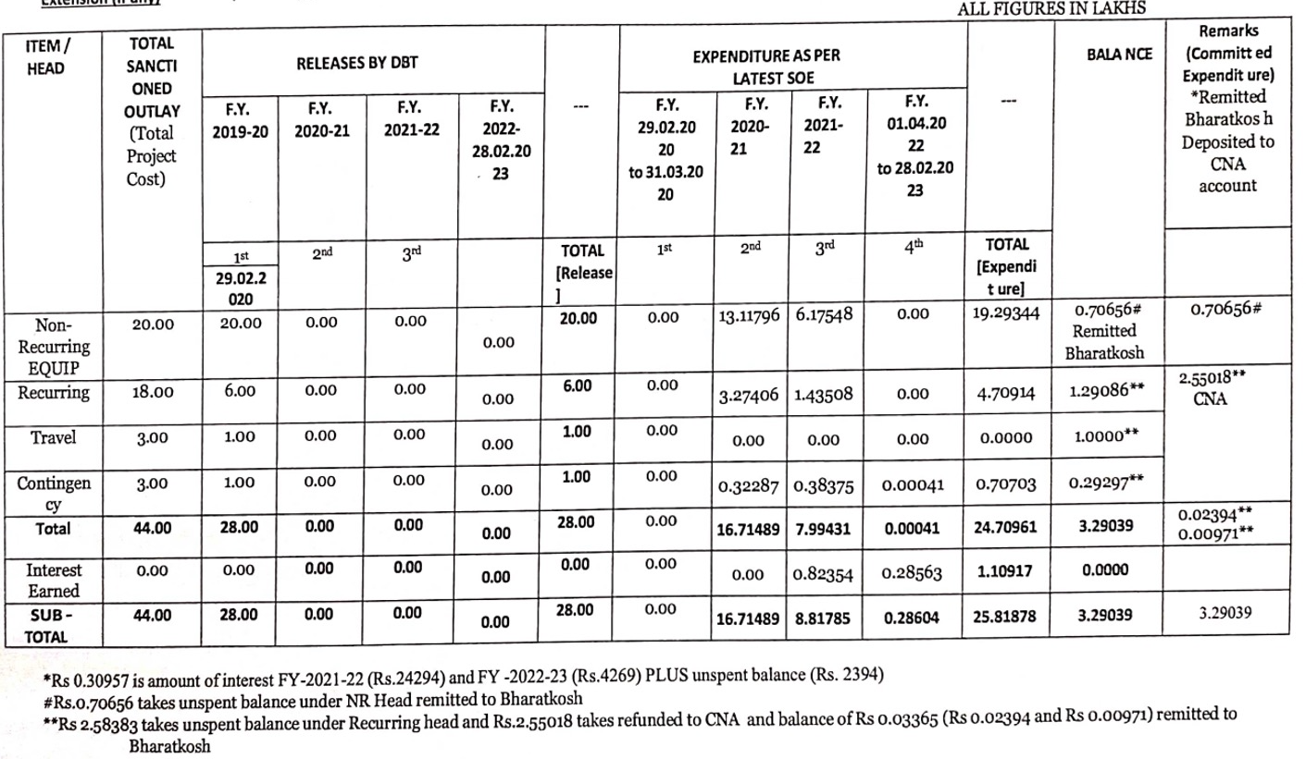
FINANCIAL DETAILS

Slide 35
Department wise Budget Requirement
Botany: NON RECURRING
Plant Growth Chamber (185 litres)
Trans Illuminator (2)
Gel Electrophoresis Assemblies (6)
Micropipettes (10)
Centrifuge (2)
Bacteriological Shaker incubater
Laminar Flow System
Water baths (4)
Auto clave
Deep fridge _20⁰C
Referigerator
TOTAL
IN LAKHS
2.60
1.00
0.90
0.50
1.00
1.00
0.50
0.50
0.50
1.00
0.50
10.00

Slide 36
Department wise Budget Requirement
Zoology: NON RECURRING
ELISA Test
PCR
Trans Illuminator (2)
Gel Electrophoresis Assemblies (6)
Micropipettes (10)
Centrifuge (2)
Bacteriological Shaker incubater
Laminar Flow System
Water baths (4)
B.O.D. Unit
Microtome
B.P. Instruments (10)
TOTAL
IN LAKHS
1.00
1.00
1.00
0.90
0.50
1.20
1.10
0.50
0.50
1.00
1.00
30.00
10.00

