Slide 1
THEORIES OF INTELLIGENCE
NEERU YADAV
Assistant Professor
T.R.K.M., Aligarh

Slide 2
Spearman’s Two- Factor Theory
General intelligence, also known as g factor, refers to a general mental ability that, according to Spearman, underlies multiple specific skills, including verbal, spatial, numerical and mechanical.
Charles Spearman, an English psychologist, established the two-factor theory of intelligence back in 1904 (Spearman, 1904). To arrive at this theory, Spearman used a technique known as factor analysis.
Factor analysis is a procedure through which the correlation of related variables are evaluated to find an underlying factor that explains this correlation.
In the case of intelligence, Spearman noticed that those who did well in one area of intelligence tests (for example, mathematics), also did well in other areas (such as distinguishing pitch; Kalat, 2014).
In other words, there was a strong correlation between performing well in math and music, and Spearman then attributed this relationship to a central factor, that of general intelligence (g).
Spearman concluded that there is a single g-factor which represents an individual’s general intelligence across multiple abilities, and that a second factor, s, refers to an individual’s specific ability in one particular area (Spearman, as cited in Thomson, 1947).
Together, these two main factors compose Spearman’s two-factor theory.

Slide 3
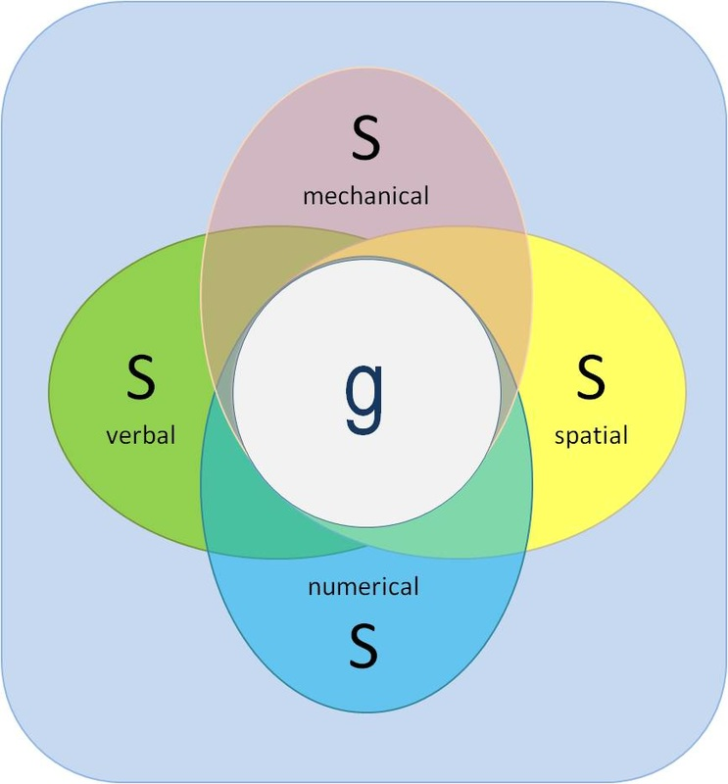
To Be Continue...
Spearman and his followers later admitted the existence of some group factors like “verbal ability, numerical ability, and possible factor of mental speed, mechanical ability, attention and imagination”. “Tests G and H have a higher correlation than that attributable to G alone. Such an additional common factor as in tests G and H became known as a group factor”.

Slide 4
Thurstone’s Primary Mental Abilities (PMA) Theory
Thurstone (1938) challenged the concept of a g-factor. After analyzing data from 56 different tests of mental abilities, he identified a number of primary mental abilities that comprise intelligence, as opposed to one general factor.
The seven primary mental abilities in Thurstone's model are verbal comprehension, verbal fluency, number facility, spatial visualization, perceptual speed, memory, and inductive reasoning (Thurstone, as cited in Sternberg, 2003).
Although Thurstone did not reject Spearman’s idea of general intelligence altogether, he instead theorized that intelligence consists of both general ability and a number of specific abilities, paving the way for future research that examined the different forms of intelligence.

Slide 5
Mental Abililty | Description
Word Fluency | Ability to use words quickly and fluency in performing such tasks as rhyming, solving anagrams, and doing crossword puzzles.
Verbal Comprehension | Ability to understand the meaning of words, concepts, and ideas.
Numerical Ability | Ability to use numbers to quickly computer answers to problems.
Spatial Visualization | Ability to visualize and manipulate patters and forms in space.
Perceptual Speed | Ability to grasp perceptual details quickly and accurately and to determine similarities and differences between stimuli.
Memory | Ability to recall information such as lists or words, mathematical formulas, and definitions.
Inductive Reasoning | Ability to derive general rules and principles from presented information.

Slide 6
Burt and Vernon’s Hierarchical Theory
British psychologists like Cyril Burt (1949) and Vernon (1960) gave an alternative scheme for the organisation of factors. At the top of the hierarchy, Vernon places that ‘G’ factor or the general cognitive factor. At the next level he places two broad group factors, corresponding to verbal-educational (v: ed) and practical-mechanical (k: m.) aptitudes. These major factors may be further sub-divided.
The verbal educational factor may be sub-divided into verbal and numerical sub-factors, and the practical mechanical factor into mechanical information, spatial, and psychomotor ability. At the lowest level of the hierarchy are the special factors. “Such a hierarchical structure thus resembles an inverted genealogical tree, with ‘g’ at the top, ’s’ factors at the bottom, and progressively narrower group factors in between.”
The represented by Spearman’s British tradition if investigation, exemplified by P.E. Vernon (1950) structure of human abilities in which human mental abilities are arranged in a hierarchy with a broad general factor (g) and split into two major ‘group’ factors, one distinguished by verbal and educational abilities (v: ed) and the other by practical or performance abilities (k : m). Each of these major group factor is then differentiated into more specific factors like Thurston’s verbal, number and space. These finally break into factors found in specific types of test. Thus, any mental performance can be described as involving percentages of g. (v : ed), verbal and others until all the factors needed to account for the performance have been determined.

Slide 7
To Be Continue...
Burt’s theory uses the concepts of general, group as well as common factors-
i. Group factors.
ii. Common factor.
He believes in a hierarchy of mental organization with many levels:

Slide 8
To Be Continue...
P.E. Vernon (1950) found ‘g’ after eight analyses to cover more than twice as much variance as all group factors combined.
After the removal of ‘g’ tests and tends to fall into two main groups:
a. Verbal-Numerical Education (v : ed) factors and
b. Practical-Mechanical-Spatial-Physical (k : m) factors.
The types themselves subdivide (v : ed) into verbal and numerical factors and (k : m) splits into spatial and manual sub-factors.

Slide 9
To Be Continue...
Intelligence is the integrative capacity of the mind and so it manifests itself at each level its quality and quantity differs at each level.
Integrative capacity-
The hierarchical level includes such factor as generalization, logic, abstraction, thought process, etc. The R₂ include aesthetic, creative activity.

Slide 10
References
https://www.simplypsychology.org/intelligence.html Intelligence: Definition, Theories and TestingBy Charlotte Ruhl , published July 16, 2020
https://johnparankimalil.wordpress.com/Meaning, Nature and Characteristics of Intelligence
Posted on November 17, 2014 by John Parankimalil
https://en.wikipedia.org/wiki/Intelligence
https://www.psychologydiscussion.net/Theories of Intelligence: Top 6 Theories |Psychology ,Deeksha
Anastasi, A. (1984). 7. Aptitude and Achievement Tests: The Curious Case of the Indestructible Strawperson.
Binet, A., Simon, T., & Simon, T. (1912). A method of measuring the development of the intelligence of young children. Chicago medical book Company.
Brooks, B. L., Holdnack, J. A., & Iverson, G. L. (2011). Advanced clinical interpretation of the WAIS-IV and WMS-IV: Prevalence of low scores varies by level of intelligence and years of education. Assessment, 18(2), 156-167.
Canivez, G. L. (2013). Psychometric versus actuarial interpretation of intelligence and related aptitude batteries.
Cattell, R. B. (1963). Theory of fluid and crystallized intelligence: A critical experiment. Journal of educational psychology, 54(1), 1.
Cherry, K. (2020). Why Alfred Binet Developed IQ Testing for Students. Retrieved from https://www.verywellmind.com/history-of-intelligence-testing-2795581

